Slide 1
GAMING CATALOGUE

Slide 2
TEAM MEMBERS
ARYAMAN MISHRA (19BCE1027)
TAMOJIT ROY (19BCE1156)
AKASH PATRA (19BCE1743)

Slide 3
PLAN
We are planning to create a gaming database in the form of a catalogue where a user can come to find info about any game that he/she wants and will also be able to up vote / down vote that game, which can be viewed by other users to decide whether the game is worth playing?
This is done for user’s convenience to choose any game…

Slide 4
CONTRIBUTIONS
TAMOJIT ROY : Database Creation
AKASH PATRA : Coding & Logic
ARYAMAN MISHRA : Designing

Slide 5
MODULES
Database Creation
GUI Creation
Linking Database with GUI & Search Optimization

Slide 6
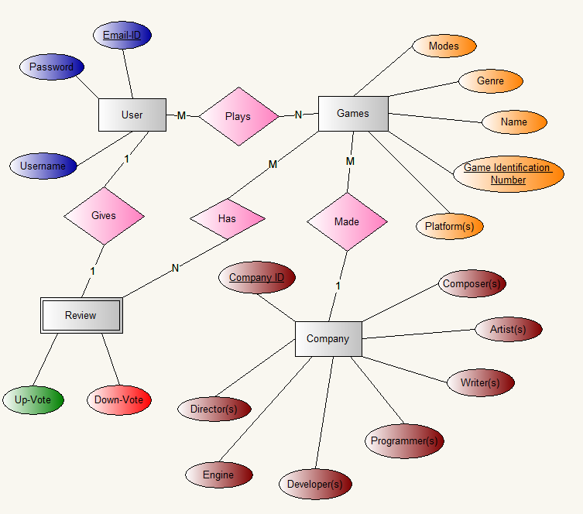
ER DIAGRAM

Slide 7
LANGUAGES & TOOLS
Javascript
HTML
MySQL
PHP
CSS
Diagram Designer

Slide 8
DATABASE USED
Relational Database

